Slide 1
CLUSTERING

Slide 2



What is a Clustering?
In general a grouping of objects such that the objects in a group (cluster) are similar (or related) to one another and different from (or unrelated to) the objects in other groups
Inter-cluster distances are maximized
Intra-cluster distances are minimized

Slide 3
HIERARCHICAL CLUSTERING

Slide 4
Hierarchical Clustering
Two main types of hierarchical clustering
Agglomerative:
Start with the points as individual clusters
At each step, merge the closest pair of clusters until only one cluster (or k clusters) left
Divisive:
Start with one, all-inclusive cluster
At each step, split a cluster until each cluster contains a point (or there are k clusters)
Traditional hierarchical algorithms use a similarity or distance matrix
Merge or split one cluster at a time

Slide 5
Hierarchical Clustering
Produces a set of nested clusters organized as a hierarchical tree
Can be visualized as a dendrogram
A tree like diagram that records the sequences of merges or splits
6
5
0.2
4
3
2
4
0.15
5
2
0.1
1
3
0.05
1
0
1
3
2
5
4
6

Slide 6
Strengths of Hierarchical Clustering
Do not have to assume any particular number of clusters
Any desired number of clusters can be obtained by ‘cutting’ the dendogram at the proper level
They may correspond to meaningful taxonomies
Example in biological sciences (e.g., animal kingdom, phylogeny reconstruction, …)

Slide 7
Agglomerative Clustering Algorithm
More popular hierarchical clustering technique
Basic algorithm is straightforward
Compute the proximity matrix
Let each data point be a cluster
Repeat
4.
5.
Merge the two closest clusters
Update the proximity matrix
6. Until only a single cluster remains
Key operation is the computation of the proximity of two clusters
Different approaches to defining the distance between clusters distinguish the different algorithms

Slide 8



Starting Situation
Start with clusters of individual points and a proximity matrix
 | p1 | p2 | p3 | p4 | p5 | .
p1
p2
p3
p4
p5
.
. .
.
.
Proximity Matrix
...
p1
p2
p3
p4
p9
p10
p11
p12

Slide 9







Intermediate Situation
After some merging steps, we have some clusters
 | C1 | C2 | C3 | C4 | C5
C1
C2
C3
C4
C5
C3
C4
C1
Proximity Matrix
C2
C5
...
p1
p2
p3
p4
p9
p10
p11
p12

Slide 10








Intermediate Situation
We want to merge the two closest clusters (C2 and C5) and update the proximity matrix.
 | C1 | C2 | C3 | C4 | C5
C1
C2
C3
C4
C5
C3
C4
Proximity Matrix
C1
C2
C5
...
p1
p2
p3
p4
p9
p10
p11
p12

Slide 11






After Merging
The question is “How do we update the proximity matrix?”
C2 U
 | C1 | C5 | C3 | C4
C1 |  | ?
C5 | ? | ? | ? | ?
C3 |  | ?
C4 |  | ?
C2 U
C3
C4
C1
Proximity Matrix
C2 U C5
...
p1
p2
p3
p4
p9
p10
p11
p12

Slide 12
How to Define Inter-Cluster Similarity
 | p1 | p2 | p3 | p4 | .
p1
p2
p3
p4
. .
Similarity?
MIN
MAX
Group Average
Distance Between Centroids
.
.
Proximity Matrix
Other methods driven by an objective
function
– Ward’s Method uses squared error

Slide 13
How to Define Inter-Cluster Similarity
 | p1 | p2 | p3 | p4 | .
p1
p2
p3
p4
.
. .
MIN
MAX
Group Average
Distance Between Centroids
.
.
Proximity Matrix
Other methods driven by an objective
function
– Ward’s Method uses squared error

Slide 14
How to Define Inter-Cluster Similarity
 | p1 | p2 | p3 | p4 | .
p1
p2
p3
p4
.
. .
MIN
MAX
Group Average
Distance Between Centroids
.
.
Proximity Matrix
Other methods driven by an objective function
– Ward’s Method uses squared error

Slide 15
How to Define Inter-Cluster Similarity
 | p1 | p2 | p3 | p4 | .
p1
p2
p3
p4
.
. .
MIN
MAX
Group Average
Distance Between Centroids
.
.
Proximity Matrix
Other methods driven by an objective function
– Ward’s Method uses squared error

Slide 16
How to Define Inter-Cluster Similarity
 | p1 | p2 | p3 | p4 | .
p1
p2
p3
p4
.
. .
×
×
MIN
MAX
Group Average
Distance Between Centroids
.
.
Proximity Matrix
Other methods driven by an objective
function
– Ward’s Method uses squared error

Slide 17
Single Link – Complete Link
Another way to view the processing of the hierarchical algorithm is that we create links between their elements in order of increasing distance
The MIN – Single Link, will merge two clusters when a single pair of elements is linked
The MAX – Complete Linkage will merge two clusters when all pairs of elements have been linked.

Slide 18
Hierarchical Clustering: MIN
 | 1 | 2 | 3 | 4 | 5 | 6
1 | 0 | .24 | .22 | .37 | .34 | .23
2 | .24 | 0 | .15 | .20 | .14 | .25
3 | .22 | .15 | 0 | .15 | .28 | .11
4 | .37 | .20 | .15 | 0 | .29 | .22
5 | .34 | .14 | .28 | .29 | 0 | .39
6 | .23 | .25 | .11 | .22 | .39 | 0
5
1
3
5
2
1
2
3
6
4
0.2
4
0.15
0.1
0.05
Nested Clusters
Dendrogram
0
3
6
2
5
4
1

Slide 19
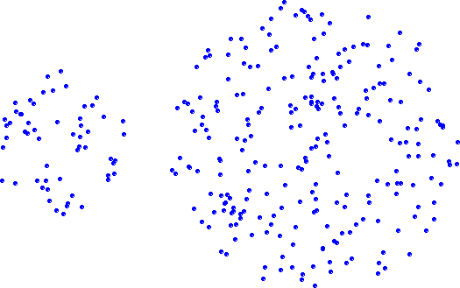
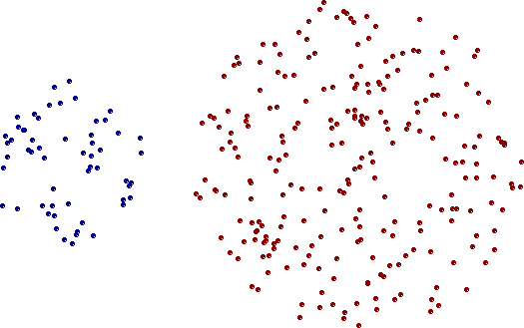
Strength of MIN
Original Points
Two Clusters
Can handle non-elliptical shapes

Slide 20
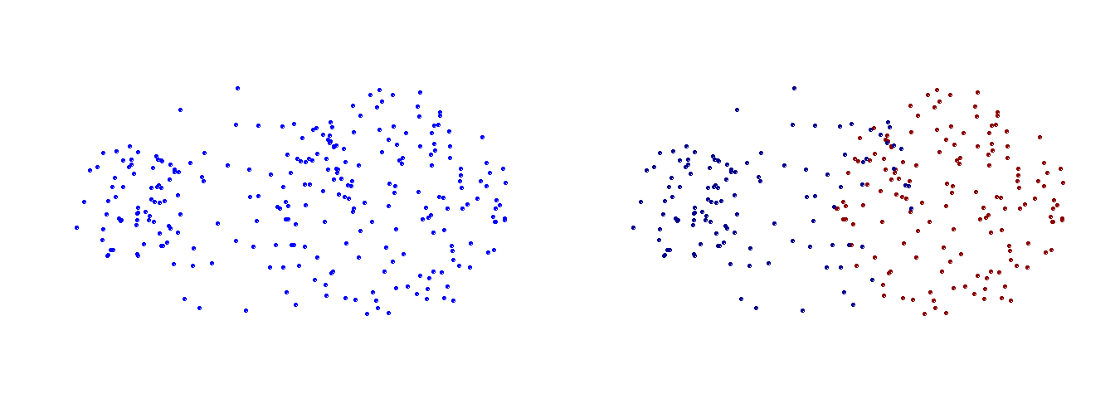
Limitations of MIN
Original Points
Two Clusters
Sensitive to noise and outliers

Slide 21
Hierarchical Clustering: MAX
 | 1 | 2 | 3 | 4 | 5 | 6
1 | 0 | .24 | .22 | .37 | .34 | .23
2 | .24 | 0 | .15 | .20 | .14 | .25
3 | .22 | .15 | 0 | .15 | .28 | .11
4 | .37 | .20 | .15 | 0 | .29 | .22
5 | .34 | .14 | .28 | .29 | 0 | .39
6 | .23 | .25 | .11 | .22 | .39 | 0
4
1
2
5
5
2
3
6
3
1
0.4
0.35
0.3
0.25
4
0.2
0.15
Nested Clusters
Dendrogram
0.1
0.05
0
3
6
4
1
2
5

Slide 22
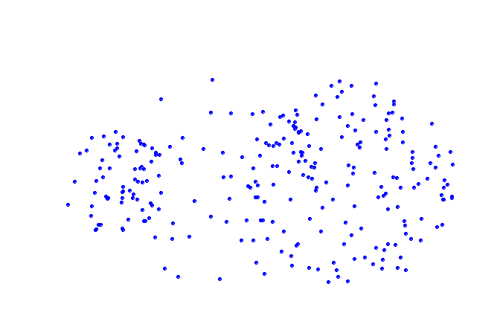
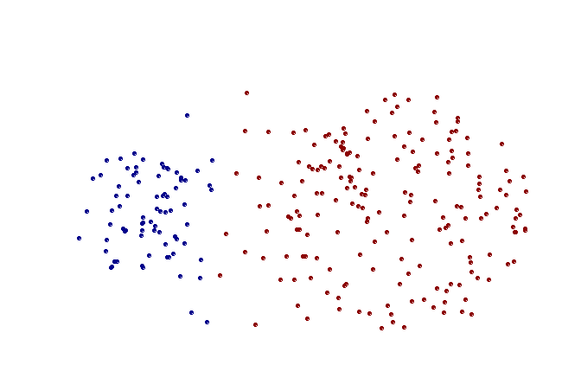
Strength of MAX
Original Points
Two Clusters
Less susceptible to noise and outliers

Slide 23
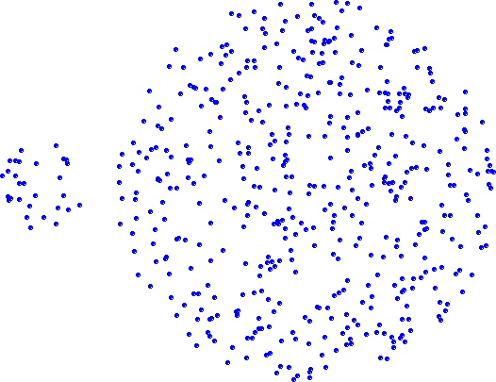
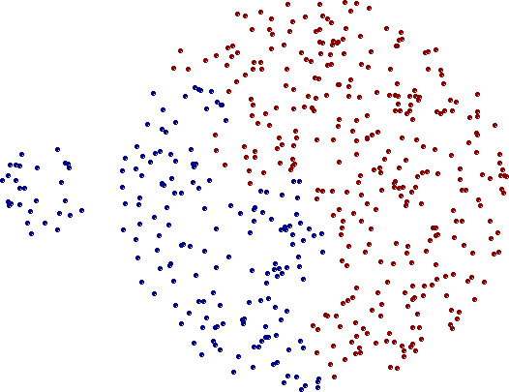
Limitations of MAX
Original Points
Two Clusters
Tends to break large clusters
Biased towards globular clusters

Slide 24
Cluster Similarity: Group Average
Proximity of two clusters is the average of pairwise proximity
between points in the two clusters.
∑proximity(p_{i} ,p_{j} )
p_{i}∈Cluster_{i}
proximity(Cluster_{i} , Cluster_{j} ) =
p ∈Cluster
j j
|Cluster_{i}|∗|Cluster_{j} |
Need to use average connectivity for scalability since total proximity favors large clusters
 | 1 | 2 | 3 | 4 | 5 | 6
1 | 0 | .24 | .22 | .37 | .34 | .23
2 | .24 | 0 | .15 | .20 | .14 | .25
3 | .22 | .15 | 0 | .15 | .28 | .11
4 | .37 | .20 | .15 | 0 | .29 | .22
5 | .34 | .14 | .28 | .29 | 0 | .39
6 | .23 | .25 | .11 | .22 | .39 | 0

Slide 25
Hierarchical Clustering: Group Average
 | 1 | 2 | 3 | 4 | 5 | 6
1 | 0 | .24 | .22 | .37 | .34 | .23
2 | .24 | 0 | .15 | .20 | .14 | .25
3 | .22 | .15 | 0 | .15 | .28 | .11
4 | .37 | .20 | .15 | 0 | .29 | .22
5 | .34 | .14 | .28 | .29 | 0 | .39
6 | .23 | .25 | .11 | .22 | .39 | 0
5
4
1
2
5
2
3
6
1
4
0.25
3
0.2
0.15
0.1
Nested Clusters
Dendrogram
0.05
0
3
6
4
1
2
5

Slide 26
Hierarchical Clustering: Group Average
Compromise between Single and Complete Link
Strengths
Less susceptible to noise and outliers
Limitations
Biased towards globular clusters

Slide 27
Cluster Similarity: Ward’s Method
Similarity of two clusters is based on the increase in squared error (SSE) when two clusters are merged
Similar to group average if distance between points is distance squared
Less susceptible to noise and outliers
Biased towards globular clusters
Hierarchical analogue of K-means
Can be used to initialize K-means

Slide 28
Hierarchical Clustering: Comparison
₁5
4
1
3
2
5
5
5
2
1
2
MIN
MAX
2
3
6
3
6
3
1
4
4
4
₁ 5
5
4
1
2
2
5
2
Ward’s Method
5
2
3
6
Group Average
3
6
3
1
1
4
4
4
3

Slide 29
Hierarchical Clustering:
Time and Space requirements
O(N²) space since it uses the proximity matrix.
N is the number of points.
O(N³) time in many cases
There are N steps and at each step the size, N², proximity matrix must be updated and searched
Complexity can be reduced to O(N² log(N) ) time for some approaches

Slide 30
Hierarchical Clustering: Problems and Limitations
Computational complexity in time and space
Once a decision is made to combine two clusters, it cannot be undone
No objective function is directly minimized
Different schemes have problems with one or more of the following:
Sensitivity to noise and outliers
Difficulty handling different sized clusters and convex shapes
Breaking large clusters

